Slide 1
Welcome
CPS Parent Information Session - Mathematics
Learning Intention: To develop an understanding on how Cattai Public School plans and implements Mathematics (Number and Algebra).
Success Criteria:
I understand how the NSW Mathematics K-10 Syllabus is organised.
I understand how the Mathematics assessment is used to track growth and achievement.
I understand how CPS plans and implements Number and Algebra tasks in the classroom.
I understand how to access Google Classroom and help my child with their homework.
Mr Hawkes

Slide 2
Overview
CPS Parent Information Session - Mathematics
NSW Mathematics K-10 Syllabus – Number and Algebra
CPS Number and Algebra Mathematics Assessment
Mathematics in the Classroom
Google Classroom and Homework
Mr Hawkes

Slide 3
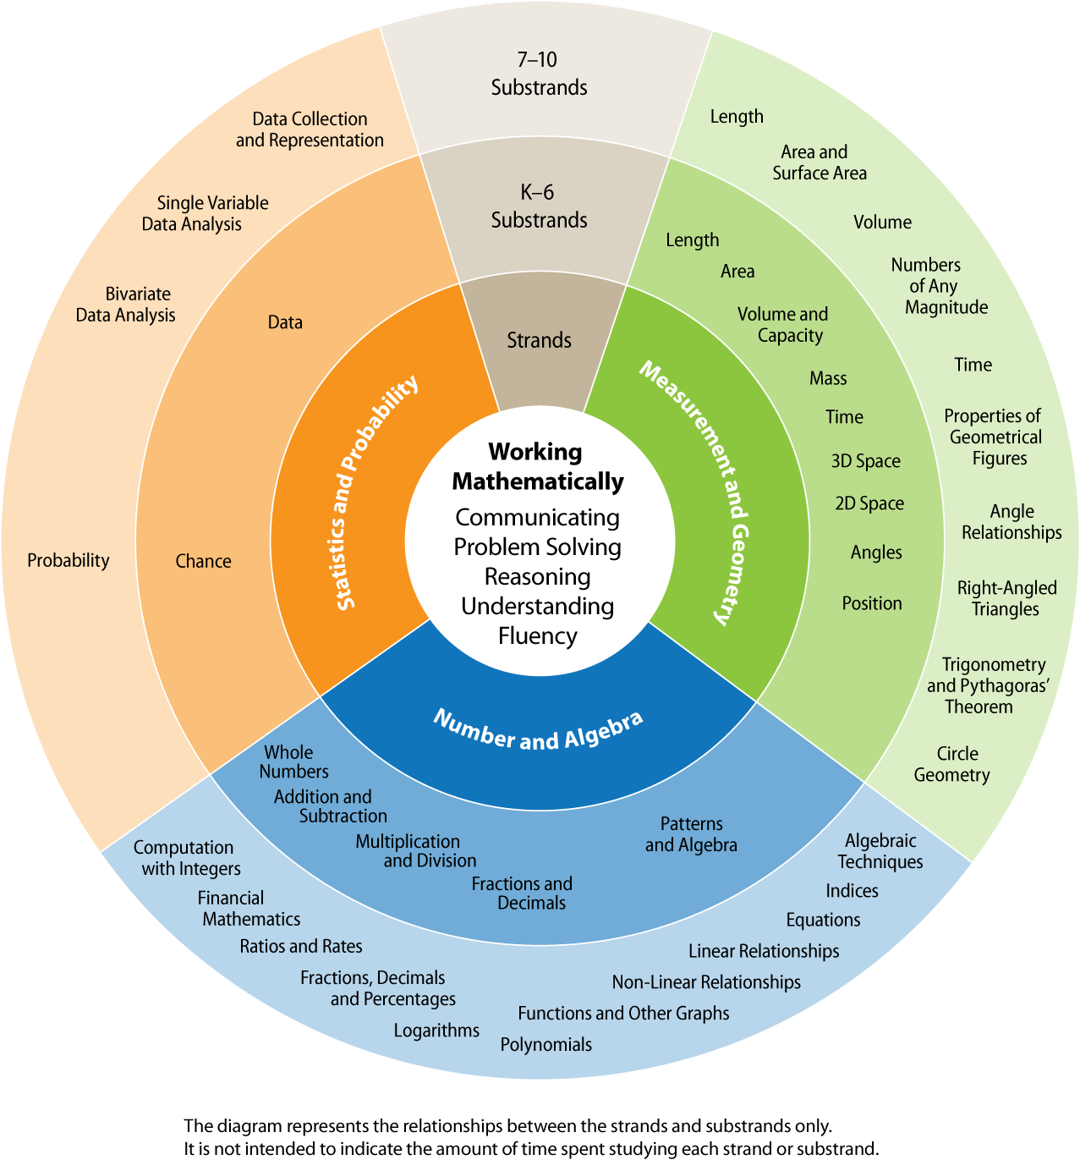
NSW Mathematics Syllabus
CPS Parent Information Session - Mathematics
‘Mathematics in K–10 provides students with knowledge, skills and understanding in Number and Algebra, Measurement and Geometry, and Statistics and Probability.’ – NSW Mathematics K-10 Syllabus.
Number and Algebra Strands:
Whole Number
Addition and Subtraction
Multiplication and Division
Fractions and Decimals
Patterns and Algebra
Mr Hawkes

Slide 4
NSW Mathematics Syllabus
CPS Parent Information Session - Mathematics
The Mathematics syllabus is organised in stages;
Early Stage 1 (ES1) - Kindergarten
Stage 1 (S1) – Year 1 & Year 2
Stage 2 (S2) – Year 3 & Year 4
Stage 3 (S3) – Year 5 & Year 6
Stage 4 (S4) – Year 7 & Year 8
Mr Hawkes

Slide 5
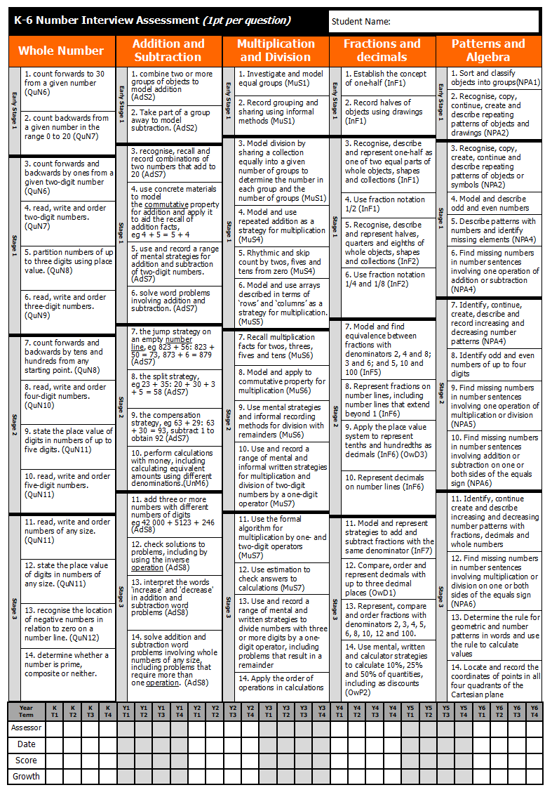
CPS Mathematics Assessment
CPS Parent Information Session
The CPS Mathematics Assessment focuses on the Number and Algebra section of the Mathematics Syllabus.
The assessment covers all the ‘Hills To Die On’ from K-6 and is organised into the stages. The ‘Hills To Die On’ are made up of two indicators per strand for ES1 and four indicators per strand for S1, S2 & S3.
Mr Hawkes

Slide 6
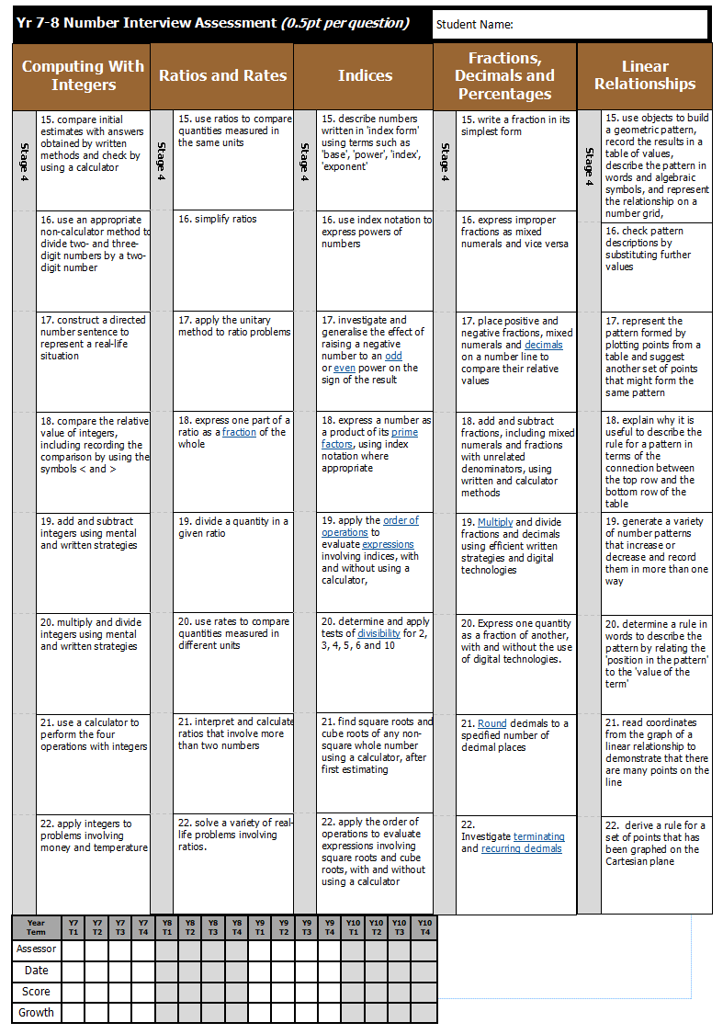
CPS Mathematics Assessment
CPS Parent Information Session
The CPS Mathematics Assessment focuses on the Number and Algebra section of the Mathematics Syllabus.
The assessment has recently been extended to cover Year 7 & 8 content (Stage 4) for those students who have already completed the Stage 3 content.
Mr Hawkes

Slide 7
CPS Mathematics Assessment
CPS Parent Information Session
How to read the assessment?
Each column represents a different strand.
Rows are grouped into stage levels.
Students are assessed once a term during learning support. They are asked their questions verbally.
When student’s have achieved an indicator, it is highlighted by the learning support teacher.
Each indicator has a series of specific questions that need to be answered correctly before it has been ‘achieved’.
Mr Hawkes
Notes:
Insert highlighted assessment - new

Slide 8
CPS Mathematics Assessment
CPS Parent Information Session
Mr Hawkes
Notes:
Insert Highlighted assessment

Slide 9
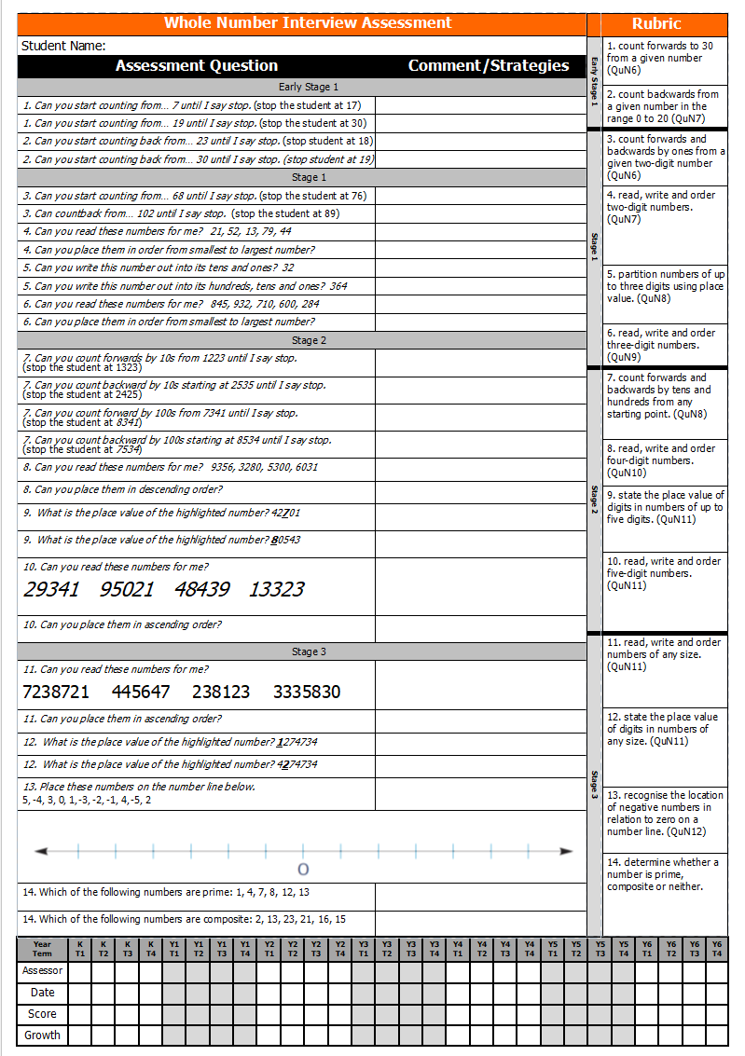
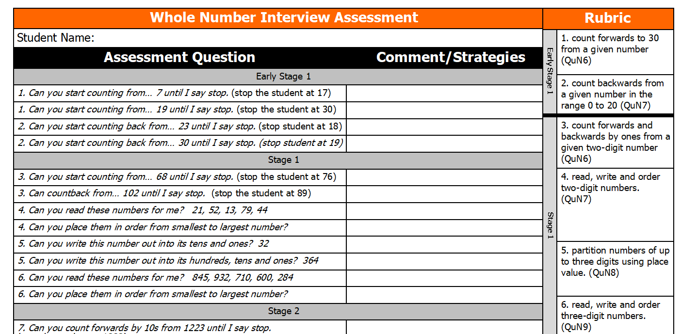
CPS Mathematics Assessment
CPS Parent Information Session
How to Read the Assessment (Example)
Mr Hawkes

Slide 10
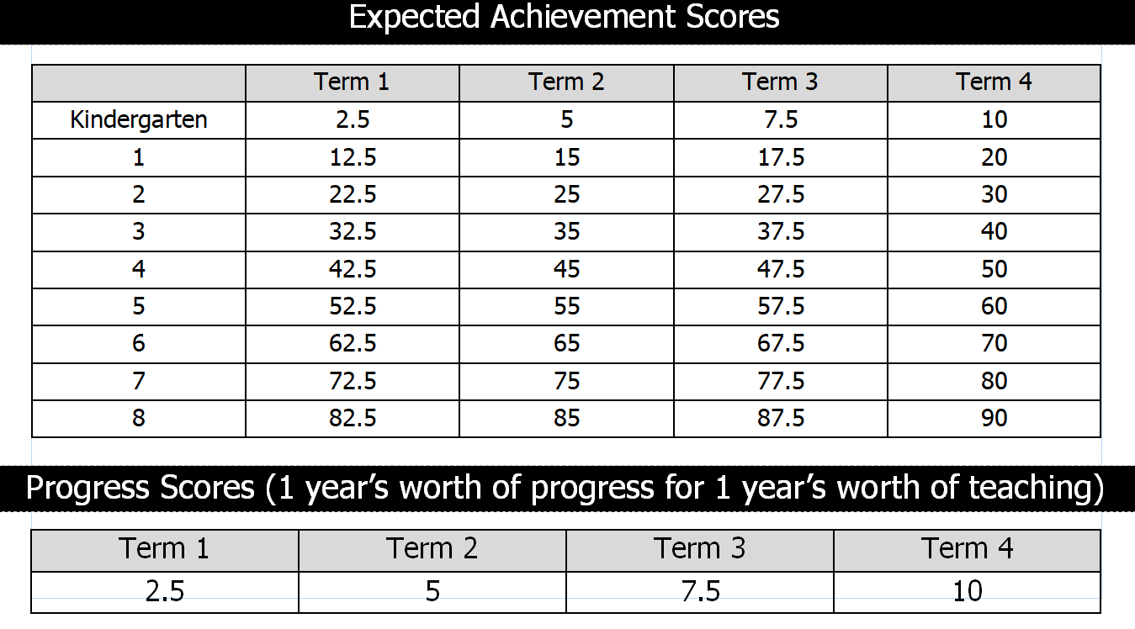
CPS Mathematics Assessment
CPS Parent Information Session
The CPS Mathematics assessment tracks both progress and achievement;
When a student achieves an indicator, this is referred to as one point of progress.
Students should achieve 10 points of progress throughout the year (2 points per strand).
Expected achievement levels can be found on the back of the assessment. This shows how many indicators (points) students should have achieved by a specific grade/term.
Expected progress levels can also be found on the back of the assessment. This shows how much progress a student should make per term.
Mr Hawkes

Slide 11
Mathematics in the Classroom
CPS Parent Information Session
How does the Assessment impact student learning?
Targeted Mathematics Groups are created based on the Assessment.
Learning goals are created based on student assessment results.
Students work in small guided groups on their individualised learning goals.
Students in older grades are given a copy of their assessment to enable them to set their own goals, reflect on feedback and track their own growth.
Mr Hawkes

Slide 12
Mathematics in the Classroom
CPS Parent Information Session
Group Organisation Example – Miss Diener (C1)
Count forwards to 30 from a given number | Count backwards from a given number (0-20) | Count forwards and backwards by ones from a given 2-digit number | Read, write and order 2-digit numbers
Student | Student | Student | Student
Student | Student | Student | Student
Student |  | Student | Student
Student |  | Student | Student
 |  | Student
Mr Hawkes

Slide 13
Mathematics in the Classroom
CPS Parent Information Session
How are Mathematics Groups run?
Targeted Mathematics Groups are created based on the Assessment (as seen above).
Each group has an opportunity to work at the target table with the teacher on their specific learning goal.
Students outside the Target group will be placed in similar ability groups, whereby they will work through a variety of independent Mathematics Activities. Activities will be targeted to each specific group and will allow for repetition and revision of specific Mathematics outcomes.
Mr Hawkes

Slide 14
Mathematics in the Classroom
CPS Parent Information Session
NOW IT’S YOUR TURN!
Hands on Mathematics Rotations
Mr Hawkes

Slide 15
Questions
CPS Parent Information Session
QUESTIONS??
Mr Hawkes

Slide 16
Mathematics Homework
CPS Parent Information Session
Where can it be found??
All CPS homework is uploaded to Google Classroom each week by Friday afternoon. Google Classroom can be accessed via a desktop computer/laptop, tablet or smart phone.
If you have no internet available – please contact the school as we are able to provide paper copies of all homework where necessary
Mr Hawkes

Slide 17
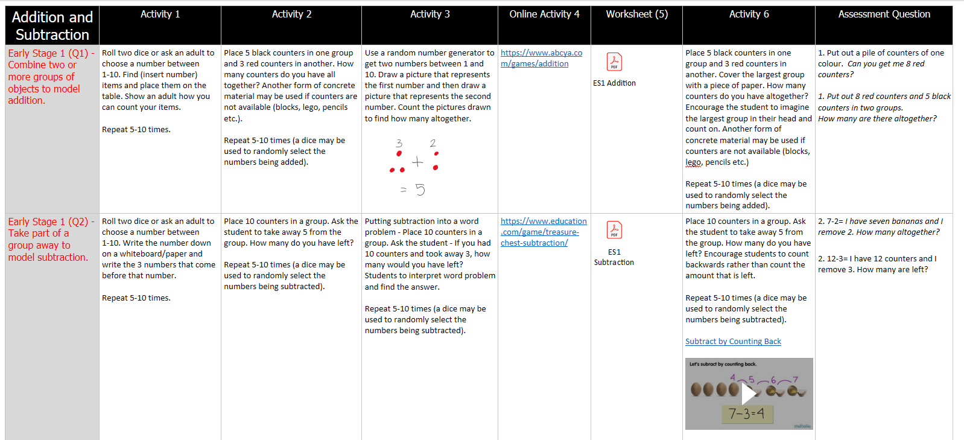
Mathematics Homework
CPS Parent Information Session
Mathematics Homework Content
During COVID-19 – A whole school Mathematics program was created that links heavily to the CPS Mathematics Assessment.
For each assessment question, there is 6 activities that allow the students to practice the syllabus content and apply their knowledge to multiple situations.
These activities are designed for students to revise the topic before being assessed, however may require some parent assistance.
Mr Hawkes

Slide 18
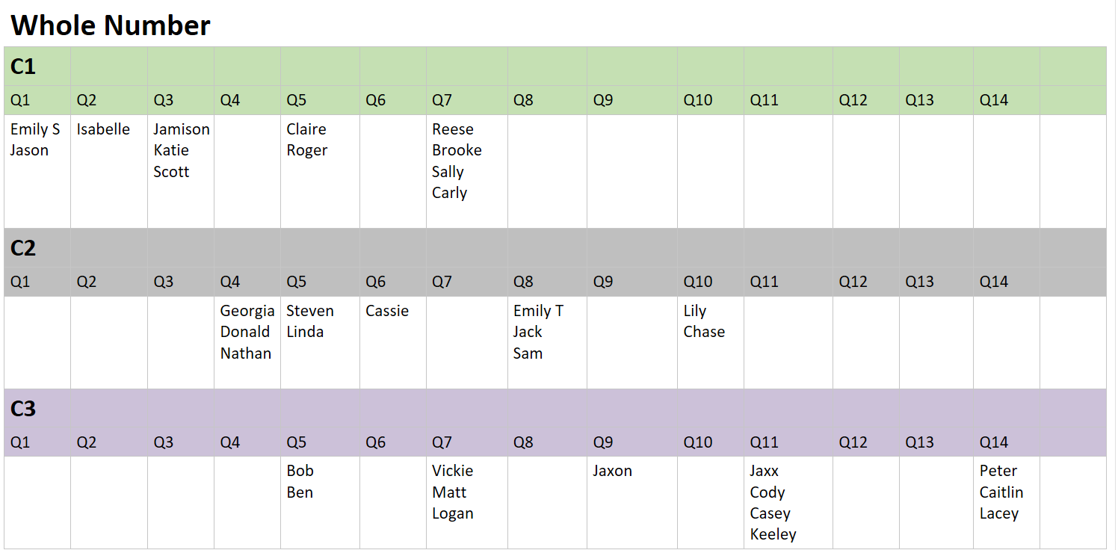
Mathematics Homework
CPS Parent Information Session
How has the Mathematics Assessment been used to set homework tasks?
All of the activities created during COVID-19 where uploaded to a separate Google Classroom.
Teachers assign students to a specific task according to their assessment results.
Teachers have the ability to differentiate according to student needs.
Mr Hawkes
Notes:
Show Teacher Google Classroom
Focus on Similarity to Mathematics Groups in Class

Slide 19
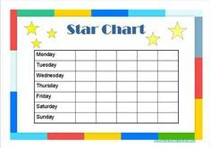
Mathematics Homework
CPS Parent Information Session
TIPS AND TRICKS
Establish a location free from distractions and stocked with homework materials such as pencils, books, IPad etc.
Set a routine that works for your child.
Create an incentive plan with extrinsic rewards.
Build the relationship with your child and their teacher.
Make homework a priority over screen time, riding motorbikes etc.
Mr Hawkes

